Slide 1
Secure and Efficient Media Delivery using Cloud Technologies
Under the guidance of:
Dr.T.V.V.Satyanarayana,
Associate Professor,
Department of ECE,
SVEC.
Submitted by:
P. Jeyanth Krishna (16121A04J5),
Syed Liyakhath (16121A04M1),
N. Alekhya (16121A04G1),
P. Asritha (16121A04J4)

Slide 2
Abstract
Now-a-days the use of digital Media has become a very common way of sharing Information, be it from personal holiday Images to confidential Intelligence reports. As such, secure and efficient sharing of such data is one of the major problem in this digital world. One way to solve this is by using Compression techniques using LZMA, Zstandard etc., in combination to best compress and deliver the data. This project also tries to solve this issue by using the well-established and highly secure encryption standard, AES-256 in combination with the RSA key exchange mechanism. All put together with an User Interface for easy access to the service can be viable solution to the problem

Slide 3
Introduction
Digital data has become more sensitive and relays more Information than ever before.
Such data is required to be at right places at right times, yet out of hands for unauthorized entities to prevent data theft.
For efficiently using such Information it also needs to be available on demand as quickly as possible.
Several techinuques are Introduced to solve this issues like Encryption of data for better security and Data Compression for faster transmission, reducing the storage requirements.
These techinques work quite well when used standalone but becomes less feasible when working on large amount of data without proper organisation
This project aims to create a Secure and Efficient way of Media Transmission for effective distribution of Media Payloads to the Clients using Cloud Technologies.

Slide 4
Literature Review
S.NO | TITLE | YEAR OF PUBLICATION | AUTHOURS | DESCRIPTION
1. 2. | Digital Image Encryption Based on Advanced Encryption Standard (AES) Cloud security ecosystem for data security and privacy | 2015 2017 | Qi Zhang ,Qun Ding Akshay Arora,Abhirup Khanna,Anmol Rastagi | It uses the AES encryption algorithm which is fast and the data will be secured in an efficient manner. It describes the cloud’s significance and importance and the data access and security features in cloud.

Slide 5
S.NO | TITLE | YEAR OF PUBLICATION | AUTHOURS | DESCRIPTION
3. 4. | Implementation of the LZMA compression algorithm on FPGA Development of an application for data compression by using the huffman algorithm | 2017 2017 | Xia Zhao ; Bing Li Iván Alvarado , Álvaro Zavala ,Marvin Linares | It explains about the lossless lzma compression technique which compresses data effectively. It tells about developing an area for applying the

Slide 6
Critical study and Analysis of the problem
Several Compression techniques and algorithms are available for data compression and each of them have their pros and cons.
Some techniques are good at providing better compression ratios but lack severely in time taken for compression, While others have a very good stats for compression speed but sacrifice compression ratios.
More variants are available that very good in handling both of these parameters but are generally proprietary and require the users to pay royalities to use them.
Furthermore when the security of such data should considered, especially when it is preserved in remote locations where there is no absolute guarantee for data security both physical – the Infrastructure where the data is located and general security.

Slide 7
Standalone Encryption itself helps deals with the issue by encrypting the data, but problems do arise when a person wants to share this data with some other person.
This “Encryption Keys” used to encrypt the data are required to be stored and transfered to the other person in a safe way.
Storing these keys along with the data makes its still possible for the intruders to access the data by grabbing the keys first and using them to decrypt the Original data.
On other hand not storing the Keys on the server means that the person sharing the data now requires a way to transfer the Keys to the receiver in a secure manner.

Slide 8
Proposed method for problem solution
A framework can be designed to solve these issues to offer better management and processing of such Information by using cloud technologies like Cloud Computing and Cloud Storage without sacrificing the Data transparency.
This framework uses AES-256 Encryption for encryption purpose and aims to add additional security by introducing RSA Encryption to assist with sharing of the encryption keys created after AES Encryption.
A PGP server for storing all the public RSA keys, and allows for safely encrypting the data for a specific Receiver.
It also aims to help in efficient data processing by dividing and evenly spreading data among many virtual machines for parallel processing to support more data intake and throuhput.

Slide 9
In addition the data is compressed using Huffman Coding and LZMA which offers high Compression ratios for storage and a new faster compression algorithm called Zstandard to precompress data before sent to the cloud to reduce bandwidth consumed when uploading to the Cloud.

Slide 10
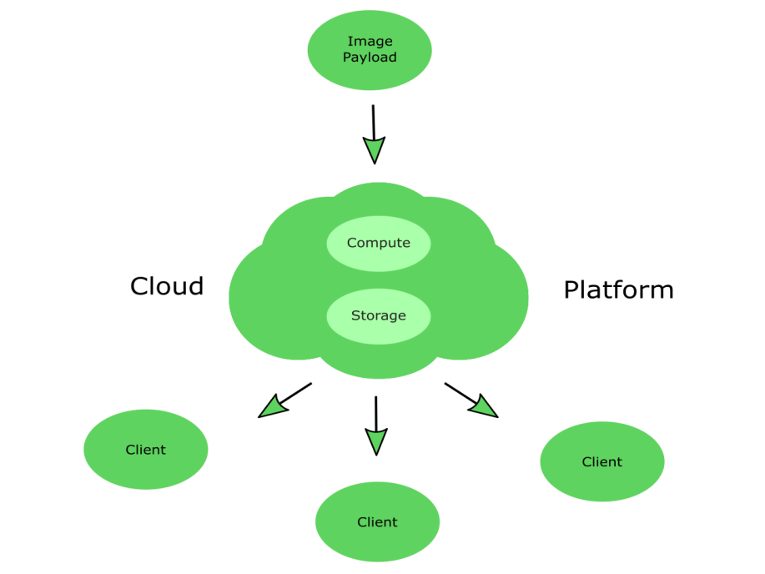
Overview of the Framework

Slide 11
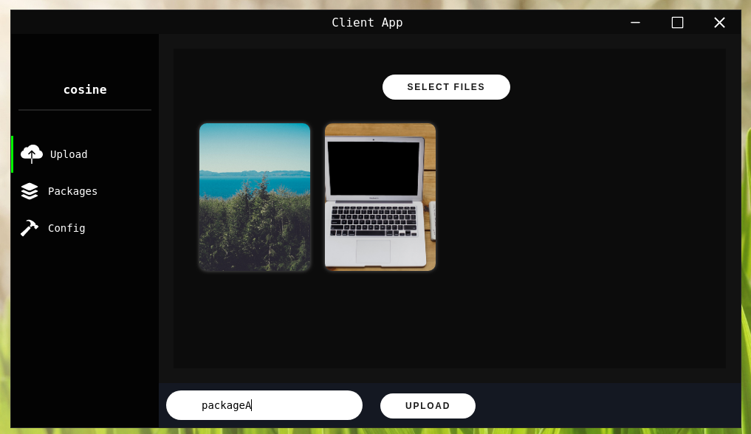
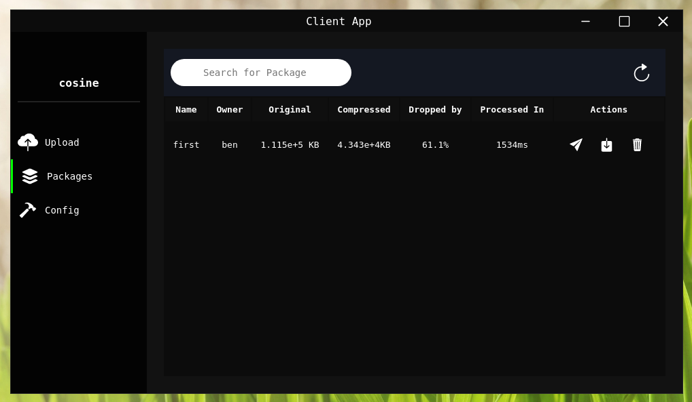
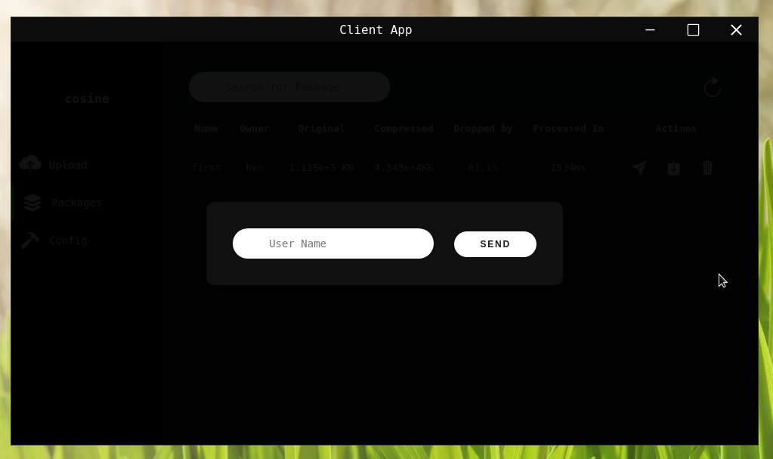
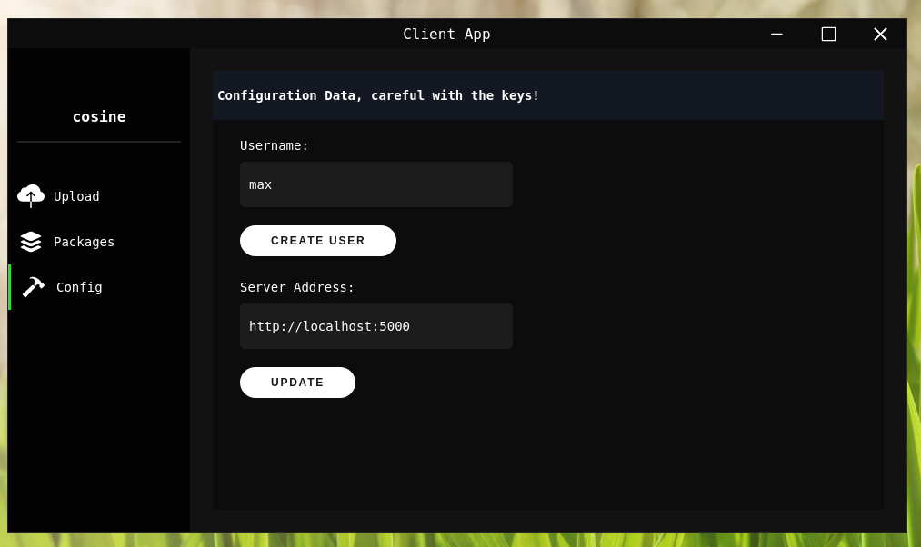
Overview of the Client

Slide 12
Components and Stages Involved
Media Compression
AES Encryption
RSA Encryption
PGP Server

Slide 13
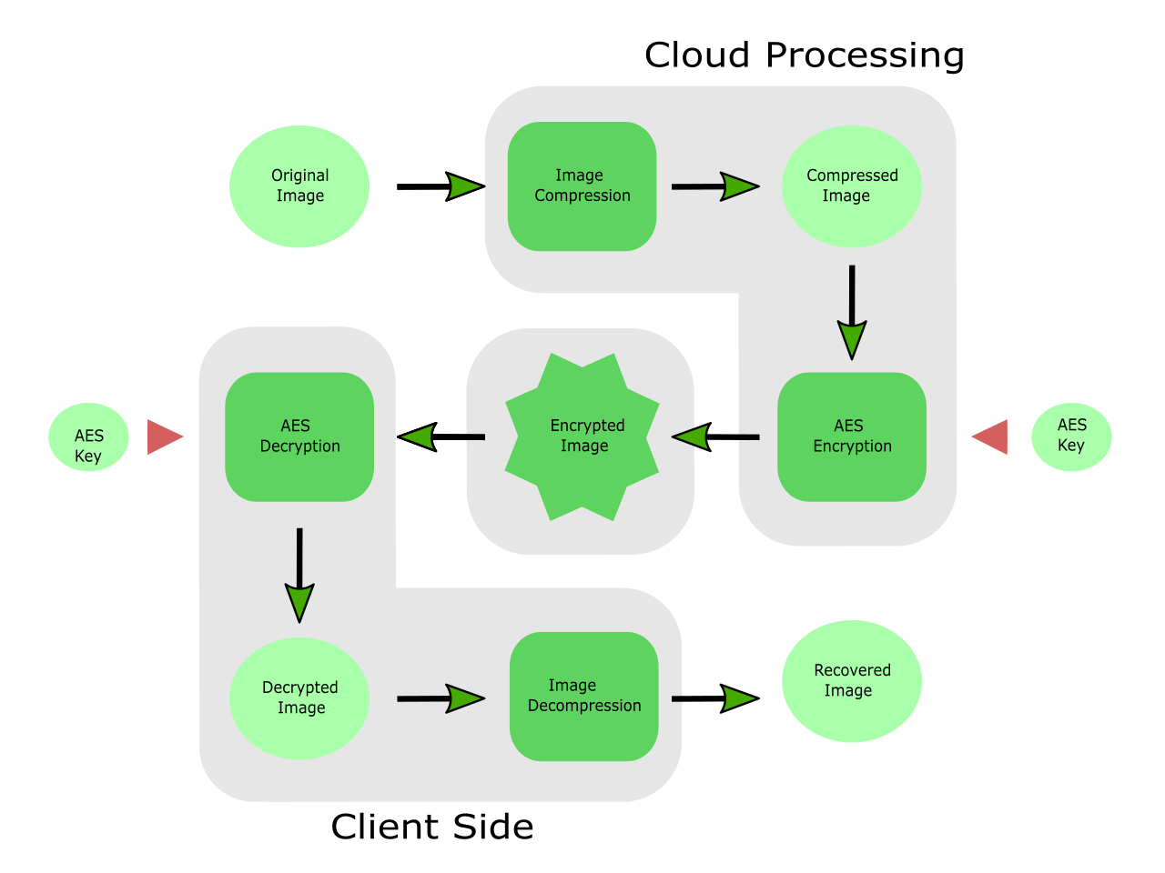
General Overview of Stages Involved

Slide 14
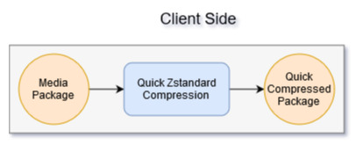
Client Side Processing
The group of media desired to be processed - refered to as “Package” here on, is initially pre-compressed using the Zstandard Compression Algorithm to obtain a quickly compressed package that has a slightly reduced size making the cloud upload process a little bit faster and helps reduce the bandwidth used to upload the package.

Slide 15
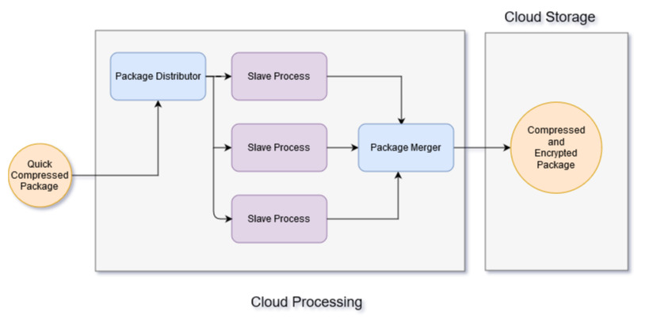
On the server side

Slide 16
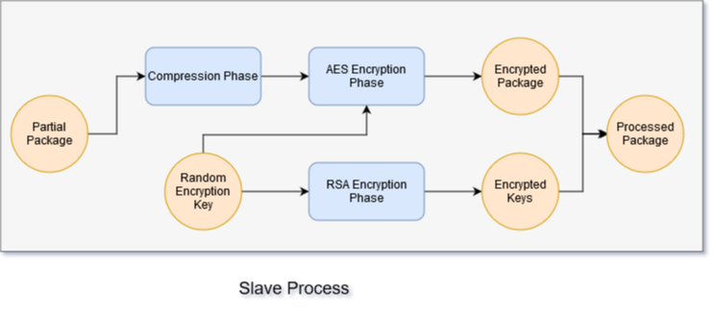
Slave Process Overview

Slide 17
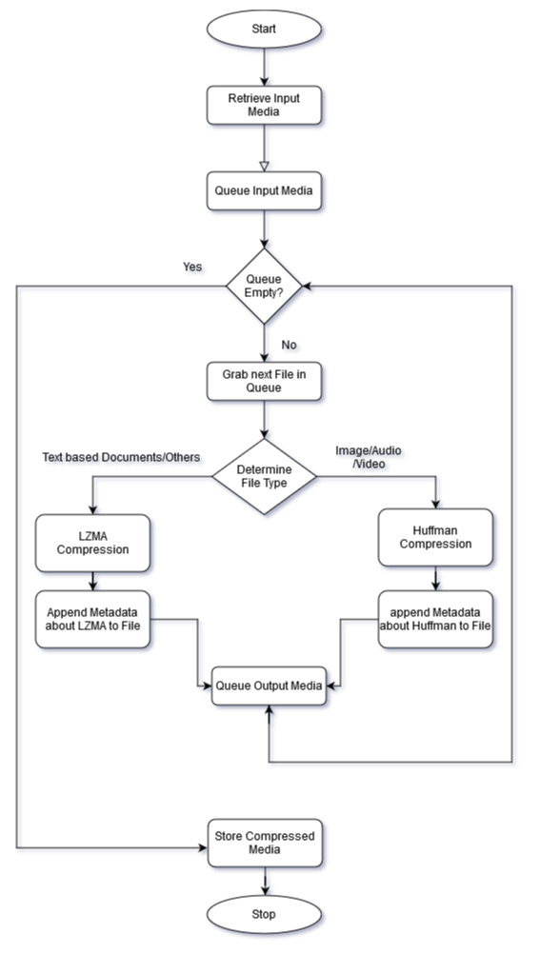
Compression Flowchart

Slide 18
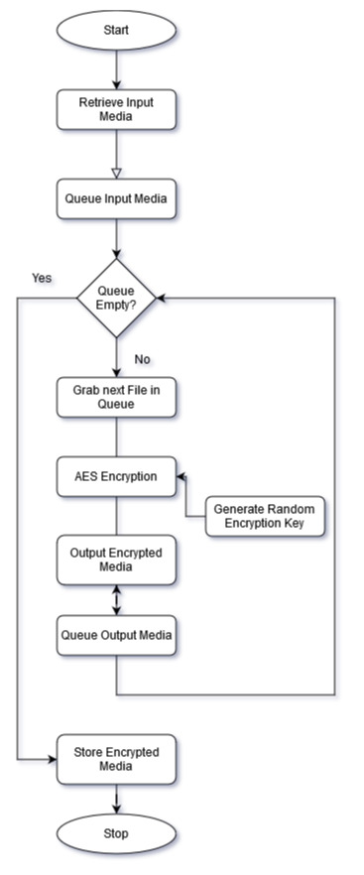
AES Encryption
Flowchart

Slide 19
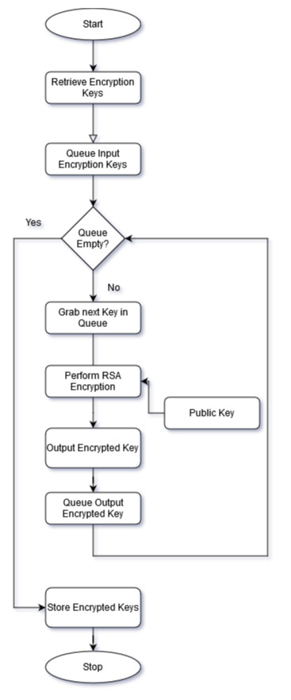
RSA Encryption Flowchart

Slide 20
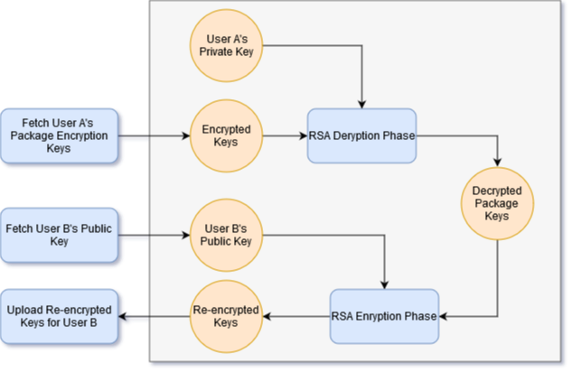
RSA Key Exchange

Slide 21
Tools Used
Flask Web Framework:
Flask is a micro web framework written in Python.
A web application framework is used to create web servers that respond to HTTP requests
It’s used inside the project to create the main Application Server, that accepts requests from clients and processess them
Cryptography Module:
A python module that allow offers several Encryption Algorithms and provides cryptographic primitives to build custom Algorithms
Notes:
<number>

Slide 22
Zstandard & LZMA Modules:
Python modules that offers zstandard and LZMA Comrpession Algorithms that can compress given Binary Data
Electron.js GUI Framework:
Electron is an open-source framework used for the development of desktop GUI applications using web technologies
GUI stands for Graphical User Interface, GUI frameworks are used to create applications that are easy to use and interact with and offers elemtents like buttons, Input boxes etc.,
It’s used inside the project to create the Client Application software that is used to access the service provided with the Server

Slide 23
Amazon Web Services:
Amazon Web Services (AWS) is the world’s leading provider of Cloud Technologies owned by Amazon Inc.,
Offers several Cloud Services like Cloud Computing, Cloud Storage, IOT Services etc.,
This project uses Two of the services offered by AWS.
Elastic Cloud Compute (EC2) - offers Virtual Machines in Cloud for Running Slaves Processes
Simple Storage Service (S3) – offers Cloud Storage Services that is Utilized by the Server to store Media & Acts as a Unified Workspace for Slave Processes

Slide 24












Sample Images Used

Slide 25
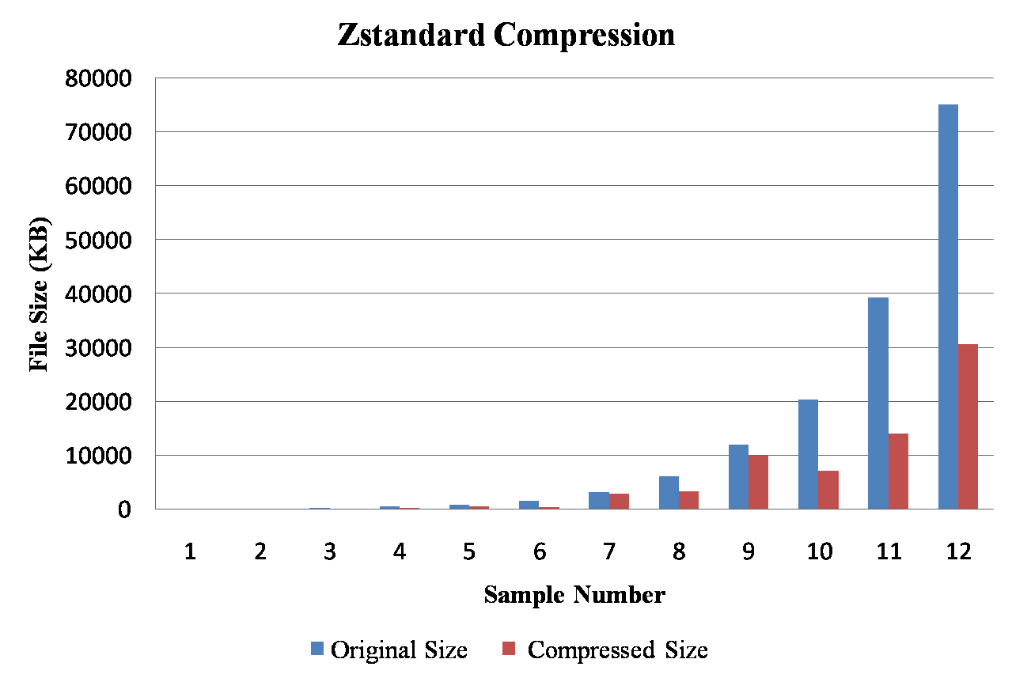
Results

Slide 26
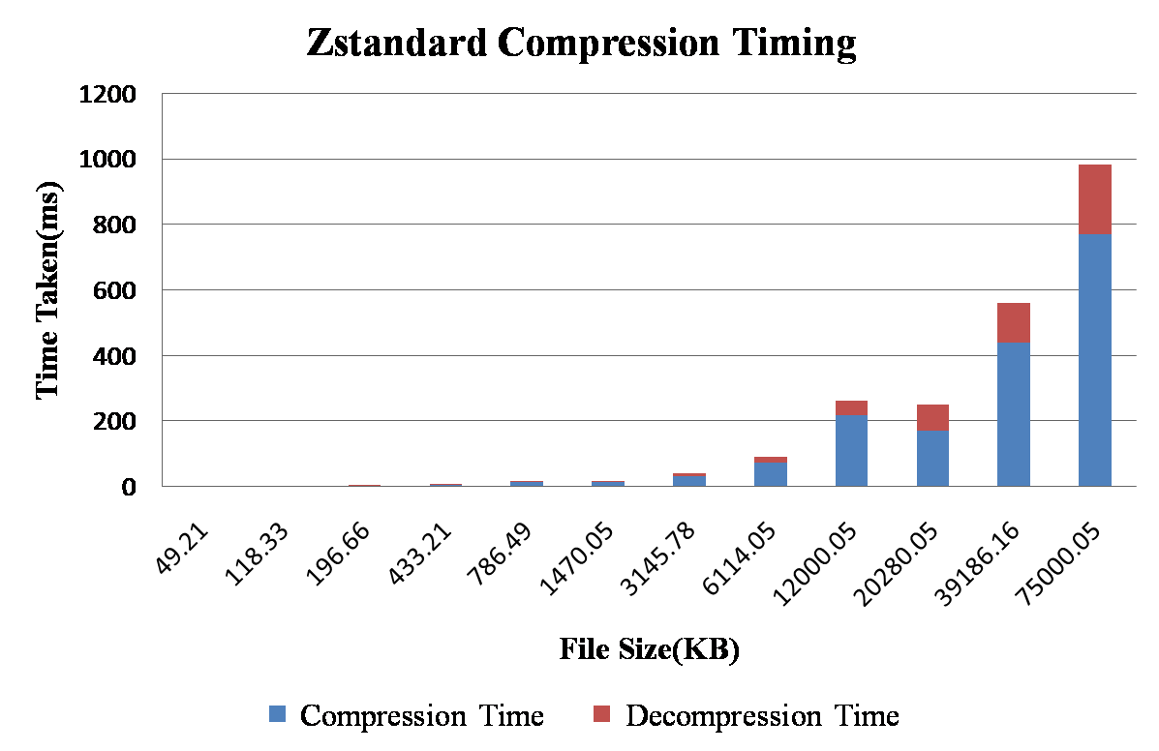

Slide 27
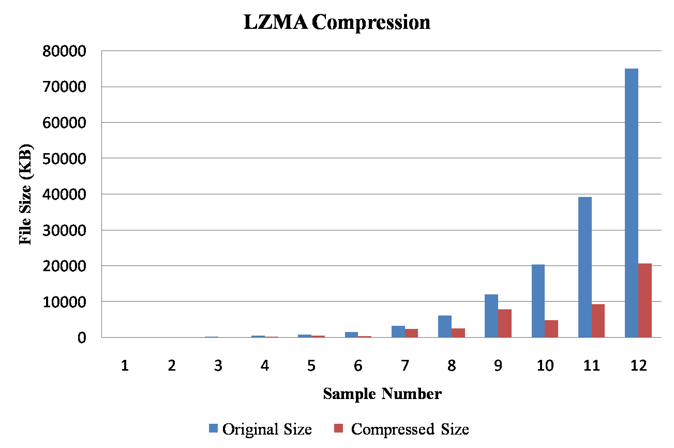

Slide 28
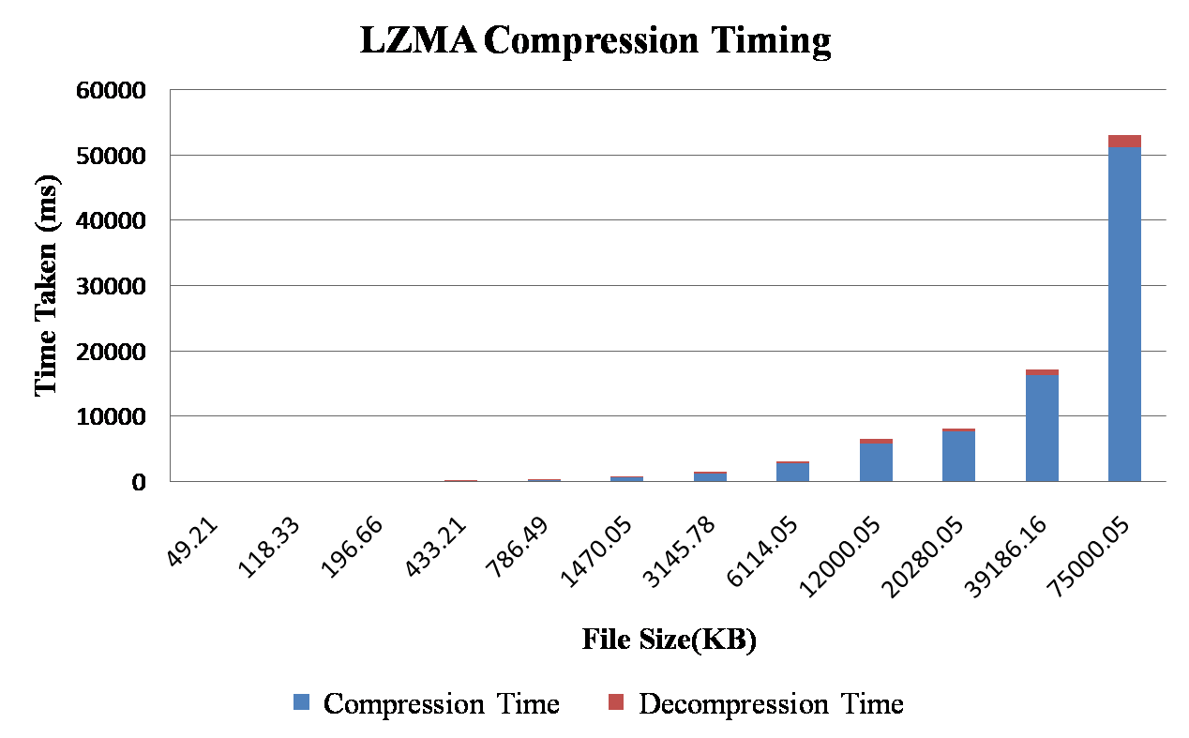

Slide 29
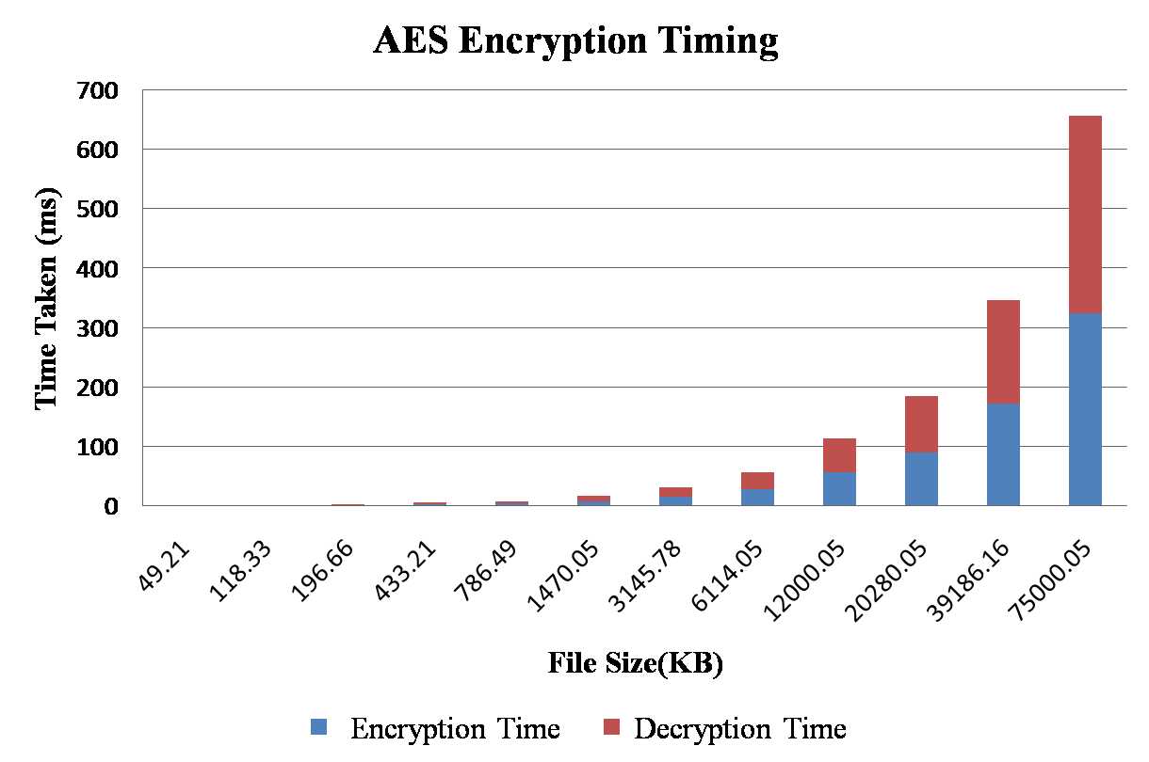

Slide 30
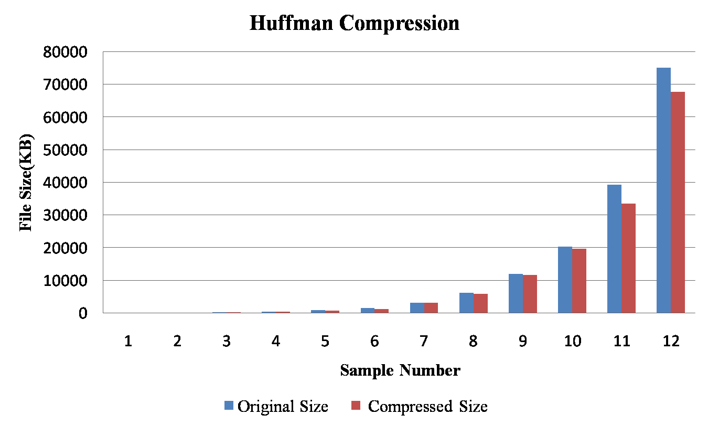

Slide 31
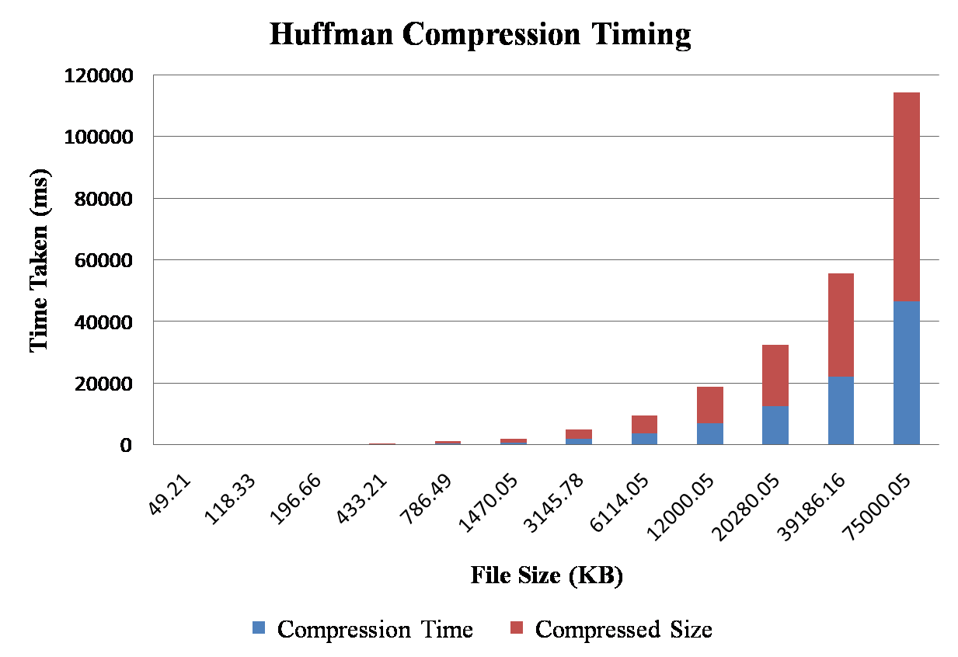

Slide 32
Conclusion
Observing the results makes it clear that each stage adds a notable improvement in the entire pipeline
The Zstandard Algorithm is found to be very fast in quickly compressing the package
The LZMA Algorithm achieved High Compression ratio with an additional perk of having very less Decompression Time
The Huffman Compression utilized by compression block nicely optimized media files
The parallel processing of the slaves increased the processing speed the package by the integral multiple amount of the slaves used.

Slide 33
References
[1] K. Sharma and K. Gupta, "Lossless data compression technique with encryption based approach," 2017 8th International Conference on Computing, Communication and Networking Technologies (ICCCNT), Delhi, 2017, pp. 1-5.
[2] S. Renugadevi and P. S. Nithya Darisini, "Huffman and Lempel-Ziv based data compression algorithms for wireless sensor networks," 2013 International Conference on Pattern Recognition, Informatics and Mobile Engineering, Salem, 2013, pp. 461-463.
[3] X. Zhao and B. Li, "Implementation of the LZMA compression algorithm on FPGA," 2017 International Conference on Electron Devices and Solid-State Circuits (EDSSC), Hsinchu, 2017, pp. 1-2.
[4] V. S. Mahalle and A. K. Shahade, "Enhancing the data security in Cloud by implementing hybrid (Rsa & Aes) encryption algorithm," 2014 International Conference on Power, Automation and Communication (INPAC), Amravati, 2014, pp. 146-149.

Slide 34
[5] N. Khanezaei and Z. M. Hanapi, "A framework based on RSA and AES encryption algorithms for cloud computing services," 2014 IEEE Conference on Systems, Process and Control (ICSPC 2014), Kuala Lumpur, 2014, pp. 58-62.
[6] K. M. Akhil, M. P. Kumar and B. R. Pushpa, "Enhanced cloud data security using AES algorithm," 2017 International Conference on Intelligent Computing and Control (I2C2), Coimbatore, 2017, pp. 1-5.
[7] P. Yellamma, C. Narasimham and V. Sreenivas, "Data security in cloud using RSA," 2013 Fourth International Conference on Computing, Communications and Networking Technologies (ICCCNT), Tiruchengode, 2013, pp. 1-6.
[8] N. Surv, B. Wanve, R. Kamble, S. Patil and J. Katti, "Framework for client side AES encryption technique in cloud computing," 2015 IEEE International Advance Computing Conference (IACC), Banglore, 2015, pp. 525-528.

Slide 35

Thank You

